Slide 1

JBOSS APPLICATION SERVER 5
ALEŠ JUSTIN, Red Hat inc.
http://www.cafebabe.org/

Slide 2

ABOUT ME
Aleš Justin
  Contributor to JBoss AS, JBoss MC, Seam, etc.
  Joined JBoss in 2006
  Currently leading JBoss Microcontainer
  Member of OSGi EEG and different JSR groups

Slide 3
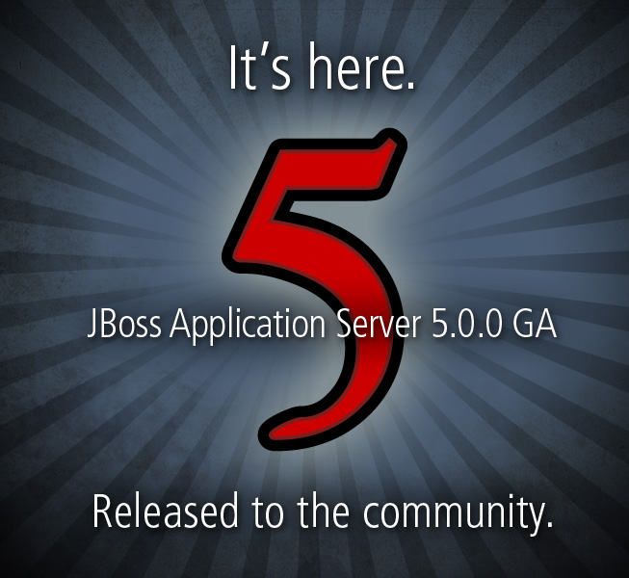
WHERE IS JBOSS 5?
www.jboss.org/jbossas/downloads

Slide 4
AGENDA
Motivation, Goals, Timeline
JBoss 5 Overview
Microcontainer Overview
    Bootstrap and the new Microcontainer
    Application deployment lifecycle
More Feature Highlights
Work in Progress
Q&A

Slide 5
JBOSS 3.X/4.X JMX MICROKERNEL CONS
No native support for POJOs
No configuration API
      Difficult to persist configuration changes
      Difficult to provide advanced tool support
Ad-hoc extensibility
      Implicit/hidden dependencies
      Few clean internal APIs/SPIs
Ability to Embed or Unit Test
      JMX Dependency and limited environments (e.g. J2ME)
      No standalone project

Slide 6

JBOSS 5 GOALS (1)
Deliver a Java EE 5 certified application server
Take every major subsystem to the next level
      Clustering Infrastructure
      Messaging Service
      Security Modules
      Transaction Manager
      Web Services Stack
      Web Server
      ...

Slide 7

JBOSS 5 GOALS (2)
Create the most advanced server runtime architecture
  Next Generation POJO-based Kernel (Microcontainer)
    Small, Standalone, Embedable, Testable
  New Aspectized Deployers
  New Configuration API (Profile Service)
  New Classloading architecture
  Support for many component models
      Legacy JMX MBean Services
      OSGi bundles
      Other...

Slide 8
AS 5 TIMELINE
4 Years R&D
JBoss AS5 Beta1, Beta2, Beta3, Beta4, CR1, CR2
JBoss AS 4.2.0 – 4.2.3
JBoss Versions
JBoss AS 4.0.0 – 4.0.5
JBoss AS 3.2.0 – 3.2.8
Time
2003
2004
2005
2006
2007
2008

Slide 9

JBOSS 4.2
Stepping Stone from AS 4.x to 5.x
Bundles AS5 features on top of the 4.x MicroKernel
      JBoss EJB3
      JBoss Web 2.x
      JBoss Transactions v4.2
      JBoss WS
  Dependencies aligned with JBoss Messaging
Basis of JBoss Enterprise Platform

Slide 10
AS 5 DIFFERENCES
JBOSS_HOME
      lib/
      common/lib/ - NEW
      server/<config>/lib
      server/<config>/deployers - NEW
Configurations
      minimal
      default
      all
      standard – NEW
      web - NEW

Slide 11
AS 5 DIFFERENCES (2)
EJB3 deployments follow stricter rules
server/xxx/conf/jboss-service.xml reduced
(and may disappear)
Many services converted from mbeans (-service.xml) to pojos (-jboss-beans.xml)
New POJO-based ServiceBindingManager
(see conf/bootstrap/binding.xml)
Farming is gone

Slide 12
THE BIG PICTURE
Runtime components wired together by the MC with dependencies [and aspects] applied across component models!
Support any component model that makes sense, but do not get married to it!

Slide 13
THE BIG PICTURE
JBoss AS 5 Runtime
Aspectized User Applications
service.xml
spring beans
.ear
OSGi
bundle
.war
…
jboss-beans
Component Deployers
Enterprise Services
Messaging
OR Mapping
MBean
Spring
Clustering
WS
POJO
Java EE
OSGi
Security
Web Server
Transactions
…
Virtual Deployer Framework
JBoss Microcontainer
JVM

Slide 14
JBOSS MICROCONTAINER
A Kernel for managing Services
A complete IoC framework
Tight JBoss AOP integration
Virtual deployment framework
New ClassLoading layer
Reflection & MetaData abstraction
Fully & Utterly extensible

Slide 15
MICROCONTAINER OVERVIEW I
Project structure
Classloading
Managed
Deployers
VFS
Reflection
Kernel
OSGi
MDR
JMX
Reliance

Slide 16
MICROCONTAINER OVERVIEW II
Reflect
  java.lang & reflection abstraction
MDR (metadata repository)
  scoping
Managed / Metatype
  Open MBeans
Kernel
  Dependency, Pojo IoC, AOP-MC-int
  Guice, Spring, JMX
VFS
  Unified resources lookup

Slide 17
MICROCONTAINER OVERVIEW III
ClassLoading
  Base, CL metadata, VFS impl
Deployers
  Structural & Real deployers
  Client / Server API
  Base, VFS impl
OSGi
  Core API façade, metadata, deployers
Reliance
  Drools
  jBPM

Slide 18
JBOSS BOOTSTRAP
run.sh / run.bat → Main
ServerLoader → Server → ServerImpl (now MC based) *
Bootstrapping MC Kernel *
bootstrap.xml *
Bootstrap interface → ProfileService
Bootstrap phases: BOOTSTRAP, DEPLOYERS, APPLICATION *
* more info on next slides

Slide 19
MC/SERVER BOOTSTRAP
// Bootstrap the kernel
BasicBootstrap bootstrap = new BasicBootstrap();
bootstrap.run();
kernel = bootstrap.getKernel();
// Register the server implementation
KernelController controller = kernel.getController();
BeanMetaDataBuilder builder = BeanMetaDataBuilder.createBuilder("JBossServer", getClass().getName());
builder.addMethodInstallCallback("addBootstrap");
builder.addMethodUninstallCallback("removeBootstrap");
controller.install(builder.getBeanMetaData(), this);

Slide 20
CONF/BOOTSTRAP.XML
<bootstrap xmlns="urn:jboss:bootstrap:1.0">
<url>bootstrap/vfs.xml</url>
<url>bootstrap/classloader.xml</url>
<url>bootstrap/aop.xml</url>
<url>bootstrap/jmx.xml</url>
<url>bootstrap/deployers.xml</url>
<url>bootstrap/bindings.xml</url>
<url>bootstrap/profile-repository.xml</url>
</bootstrap>

Slide 21
BOOTSTRAP PHASES
BOOTSTRAP
  conf/jboss-service.xml
DEPLOYERS - deployers/
  ejb3, jca, web, aop, Seam, dependency, …
APPLICATION - deploy/
  JBoss & user deployments
Hot deployment scanner
  deploy/hdscanner-jboss-beans.xml

Slide 22
SEAM BOOKING APPLICATION
jboss-seam-booking.ear
    META-INF → application.xml, jboss-app.xml
    lib
    jboss-seam.jar
    jboss-seam-booking.jar
        META-INF → ejb-jar.xml, persistence.xml
    jboss-seam-booking.war
        WEB-INF → web.xml, components.xml

Slide 23
SEAM BOOKING LIFECYCLE
jboss-seam-booking.ear → EarStructure
    META-INF → EarMetaData, JBossAppMetaData
    lib → ear classpath entry
    jboss-seam.jar → JarStructure
    jboss-seam-booking.jar → JarStructure
        META-INF → JBossMetaData, PersistenceUnit
    jboss-seam-booking.war → WarStructure
        WEB-INF → JBossWebMetaData, Seam-int

Slide 24
DEPLOYER STAGES
NOT_INSTALLED – initial state
PARSE – generate metadata from xml descriptors, etc.
POST_PARSE – transform metadata
PRE_DESCRIBE – introduce dependencies
DESCRIBE – establish dependencies
CLASSLOADER – create classloaders
POST_CLASSLOADER – AOP, annotations processing
PRE_REAL – last chance to transform metadata
REAL – runtime components created
INSTALLED – fully initialized runtime component
Not Installed
PreInstall
Describe
Instantiated
Configured
Create
Start
Installed
MC
Parsing
Describe
ClassLoader
Real

Slide 25
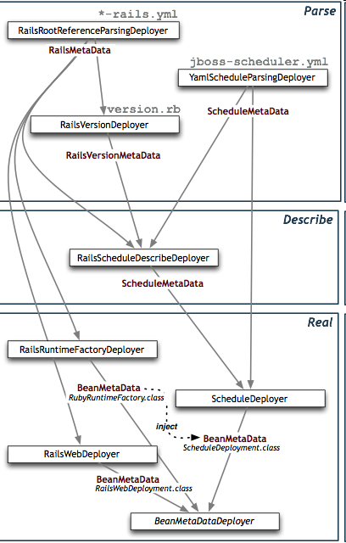
JBOSS RAILS
OddThesis.org (BMW)
  Run Rails apps on JBossAS
Excellent use case of VDF
  Structural deployer
    config/environment.rb
  Fine grained real deployers
Re-use existing deployers
EASY ;-)

Slide 26
JBOSS & WebBeans RI
Smart defaults
  WebBeans API classpath addition
  Isolated ClassLoading
  Custom WebBeans Interceptors
  Custom WebBeans Servlet Listener
  …
Integrating MC runtime with WB components
  Re-using resources scanning
  Services as first class citizen in WB

Slide 27
JBOSS & WebBeans RI DEPLOYERS
<!-- Responsible for discovering Web Bean files -->
<bean name="WebBeansFilesDeployer"
class="org.jboss.webbeans.integration.microcontainer.deployer.metadata.WebBeansFilesDeployer"/>
<!-- Responsible for discovering Web Bean classes -->
<bean name="WebBeansDiscoveryDeployer" class="org.jboss.webbeans.integration.microcontainer.deployer.env.WebBeanDiscoveryDeployer"/>
<!-- Responsible for pushing the Web Beans RI onto the application classpath -->
<bean name="WebBeansWebUrlIntegrationDeployer" class="org.jboss.webbeans.integration.microcontainer.deployer.cl.WebBeansWebUrlIntegrationDeployer"/>
<!-- Responsible for inserting the Web Beans RI EJB interceptor -->
<bean name="PostEjbJarMetadataDeployer" class="org.jboss.webbeans.integration.microcontainer.deployer.metadata.WBEjbInterceptorMetadataDeployer"/>
<!-- Responsible for enabling classloader isolation for Web Bean jars -->
<bean name="PostJBossMetadataDeployer" class="org.jboss.webbeans.integration.microcontainer.deployer.metadata.PostJBossMetadataDeployer"/>
<!-- Responsible for enabling classloader isolation for Web Bean wars -->
<bean name="PostJBossWebMetadataDeployer" class="org.jboss.webbeans.integration.microcontainer.deployer.metadata.PostJBossWebMetadataDeployer"/>
<!-- Responsible for adding the Web Beans RI listener to the Servlet -->
<bean name="PostWebMetadataDeployer" class="org.jboss.webbeans.integration.microcontainer.deployer.metadata.PostWebMetadataDeployer"/>

Slide 28
JBOSS MESSAGING V1.4.1
High Performance JMS 1.1 compliant provider (Java5 only)
XA implementation/integration with JBoss Transactions
Clustered Queues and Topics (out-of-the-box)
Intelligent message redistributions
Transparent failover
In memory message replication
Support for very large messages & paging
JDBC PersistenceOracle, MySQL InnoDB, PostgreSQL, Sybase, SQLServer
... too many features to mention :-)

Slide 29
CLUSTERING (JBC 3.0.1 / JGROUPS 2.6.7)
Buddy replication for SFSBs
Multi Version Concurrency Control (MVCC)
Much improved EJB3 Entity/Hibernate Caching
Sharable JGroups channels
Performance improvements in JGroups
etc…

Slide 30

JBOSS WEB 2.1.1 (TOMCAT ON STEROIDS)
Java Connectors over JBoss Native (over Apache APR) match Apache httpd performance
      High concurrency (10k+ connections)
      Static file handling (low memory/cpu usage)
      Integrates OpenSSL (x6 - x10 performance)
      Linux, HP-UX, Solaris, Windows
Just drop jboss native in JBOSS_HOME/bin/native
…
INFO [AprLifecycleListener] Loaded Apache Tomcat Native library 1.1.11.
INFO [AprLifecycleListener] APR capabilities: IPv6 [true], sendfile [true], accept filters [false]
INFO [Http11AprProtocol] Initializing Coyote HTTP/1.1 on http-127.0.0.1-8080
INFO [AjpAprProtocol] Initializing Coyote AJP/1.3 on ajp-127.0.0.1-8009
...

Slide 31
COMPONENT UPDATES
JBoss Transactions
JBoss WebServices
JBoss AOP
Hibernate & friends
…

Slide 32

OSGI SUPPORT
Existing features
  Class(loading) or generic deployment dependencies
  Contextual injection / callback
Core OSGi Framework API
A Facade on top of the existing Microcontainer API
  Service Registry
  OSGi Bundle Repository (OBR)
  Declarative Services Support (DSS)
NIH Syndrome?
We want full integration with the MC runtime:
  AOP
  Metadata
  VFS
  Legacy JMX
  Fine grained dependencies

Slide 33
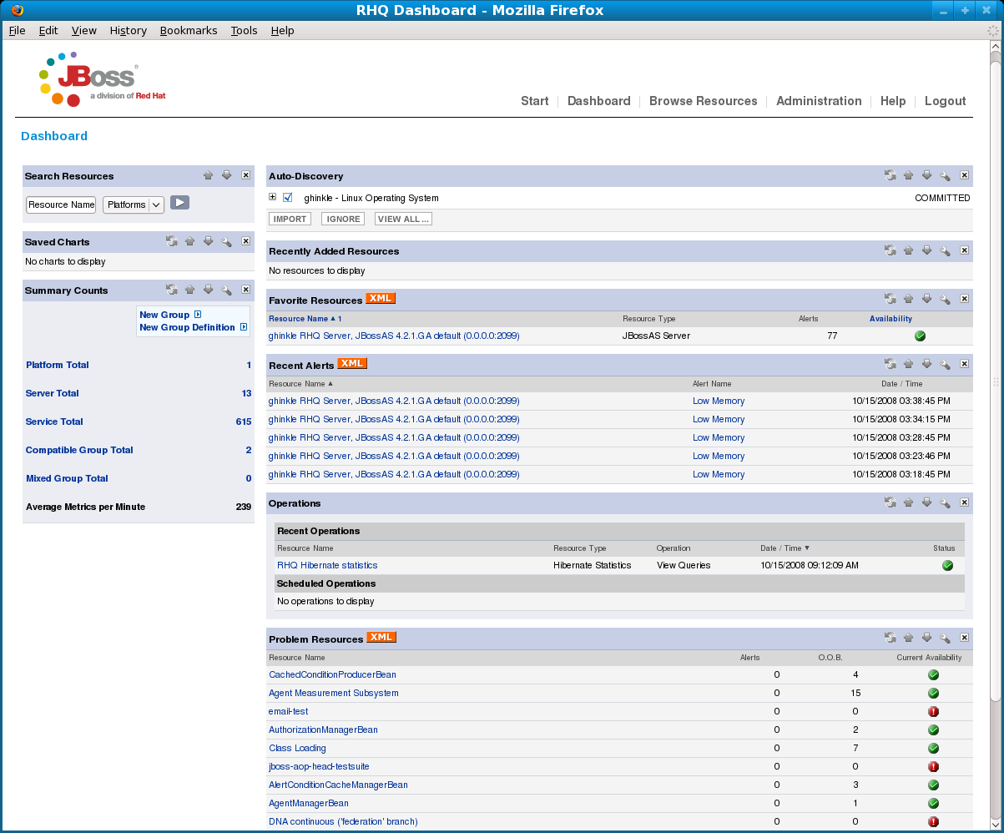
EMBEDDED JOPR
New Management Console - http://www.jboss.org/embjopr/

Slide 34
MOD-CLUSTER
Dynamic configuration of httpd workers
      Static list
      Dynamic discovery
Server-side load balance factor calculation
Fine grained web-app lifecycle control

Slide 35
AND MORE…
EJB3 standalone
EJB3.1 / Web Profile / Web Beans / Java EE 6
...
Document, explain, blog, experiment, test-drive, have fun and spread the word :-)

Slide 36
Q&A
www.jboss.org/jbossas
www.jboss.org/jbossmc
ales.justin@jboss.org
Any related JBoss user/dev forum

Slide 37
GET JBOSS 5!
www.jboss.org/jbossas/downloads

